Slide 1
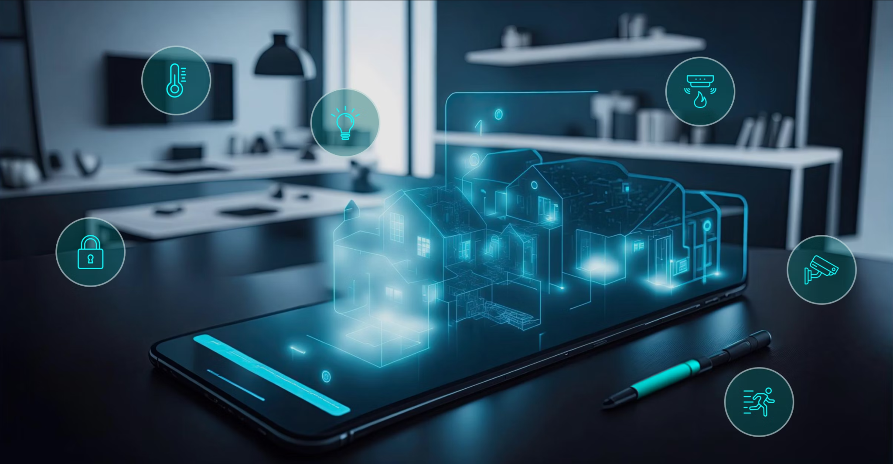

Project name: Smart Home Automation
Team members: Nick Tool, Tyler Mayou, Matthew McLean
Sponsor: Souryendu Das
Notes:
Michelle

Slide 2
Project Summary
The Problem: “Smart home systems are often composed of many different components from different companies. This can make it very difficult for a user to combine devices and implement a fully functional system for their own personal living or working space.”
Our Goal: “Develop a basic smart home automation system that allows users to control a few essential home appliances (like lights and speakers) via a mobile app and a simple web interface. The system will use IoT/non-IoT devices and a local server and online database.”
Picture / Diagram here
Notes:
Kyle

Slide 3
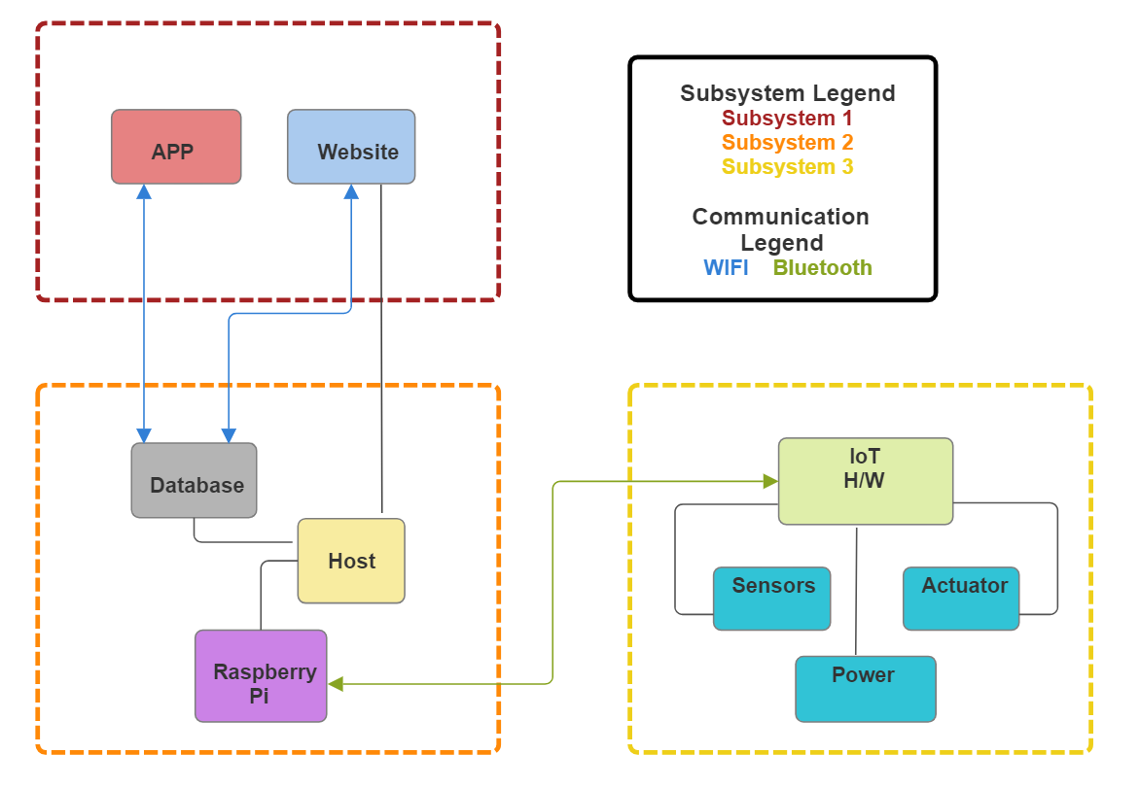
Project/Subsystem Overview
Matthew McLean
Tyler Mayou
Nick Tool
Notes:
Eric

Slide 4
Major Project Changes for 404
Public IP address instead of private
Major mobile and web app graphics/layout enhancements
Integrate light bulb and relay instead of using LED
Notes:
Eric

Slide 5
Project Timeline
Continue and finalize subsystems from 403
Final Demo/Presentation/Report
Begin Integration
Subsystems complete and ready for integration
Updates and continue integration
Finalize Integration
We are here
Notes:
Eric

Slide 6
Mobile and Web App
Matthew McLean
Accomplishments since 403 0 hrs of effort | Ongoing progress/problems and plans until the next presentation
Nothing has been done since 403 The Web and Mobile App are both still functional | In the next two weeks I will work on updating the graphics and layouts. Meet with sponsor to get details about security features he requested and research them.

Slide 7
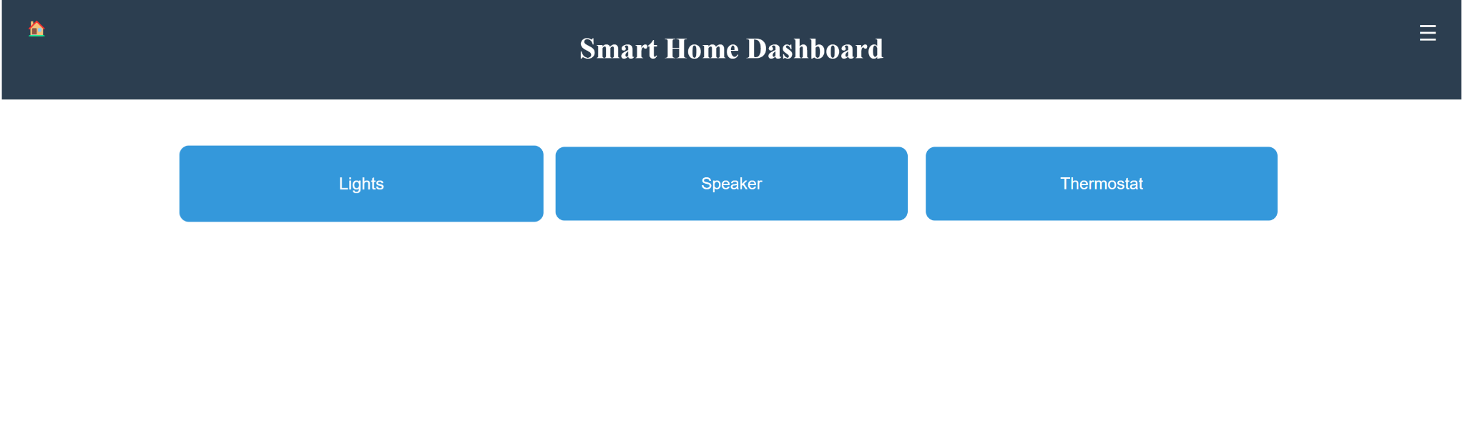
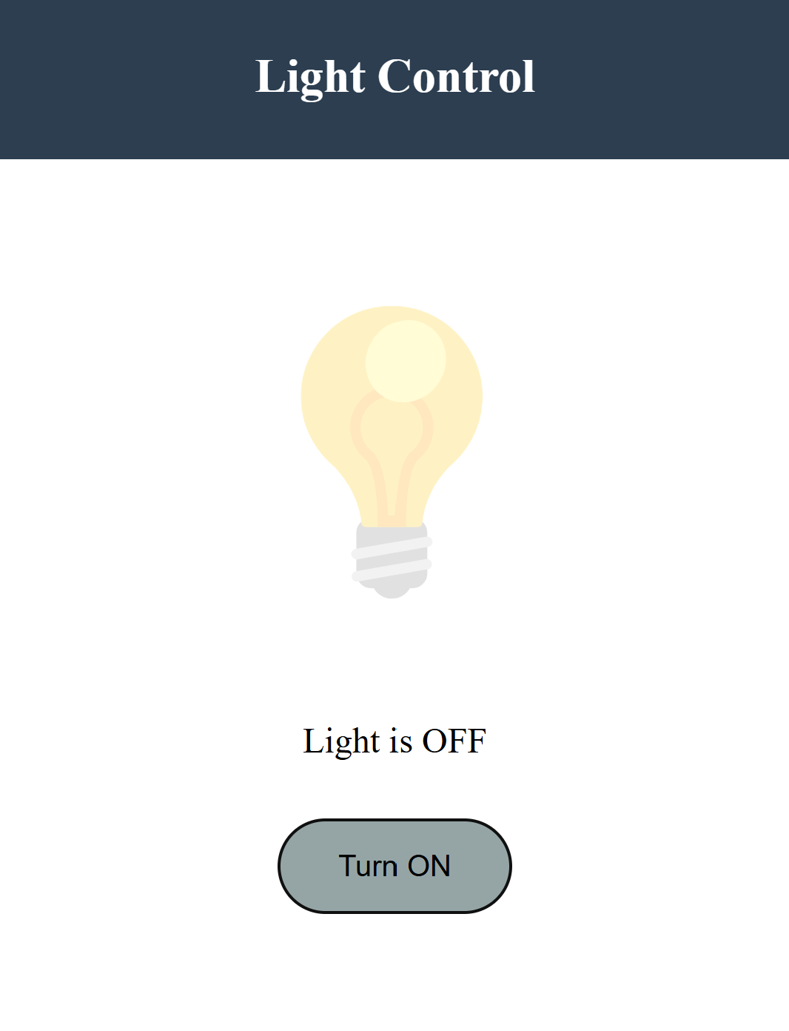
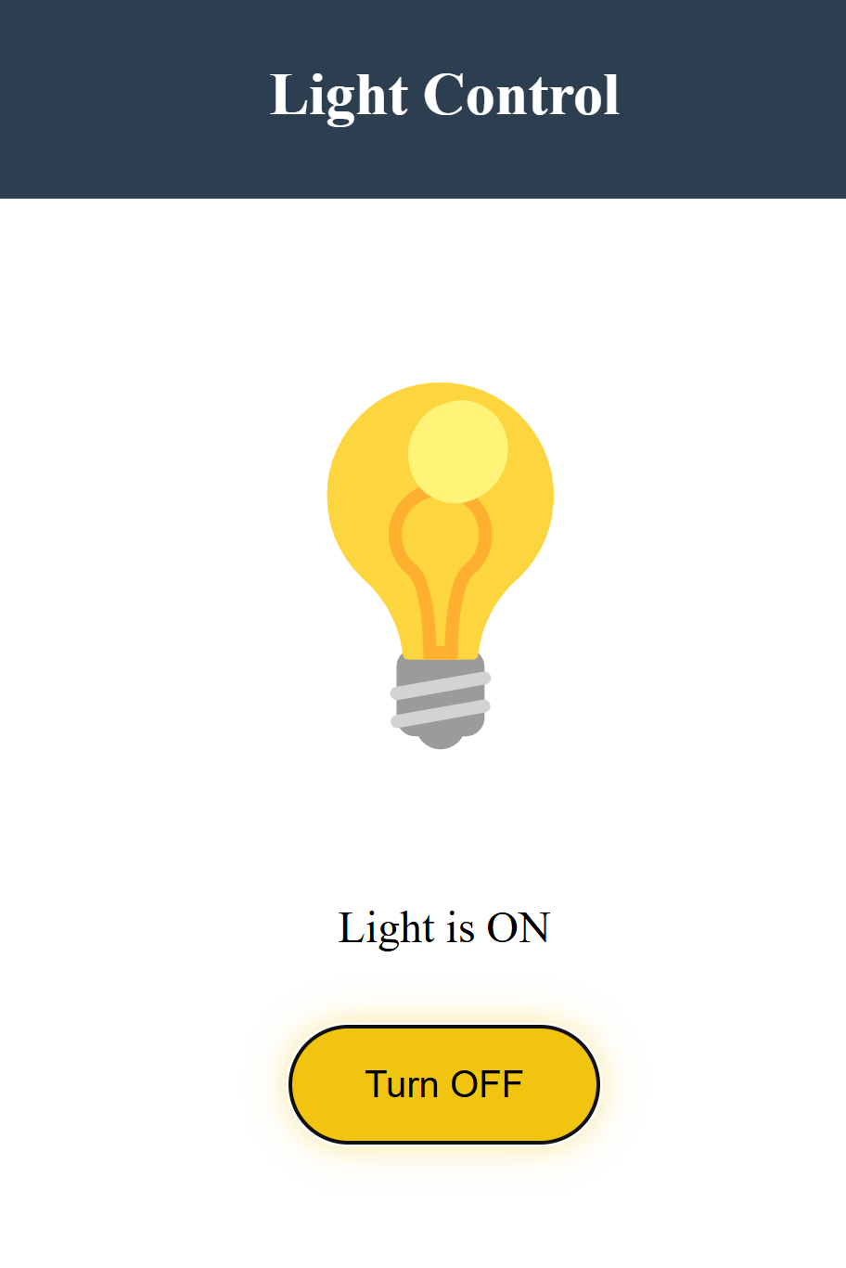
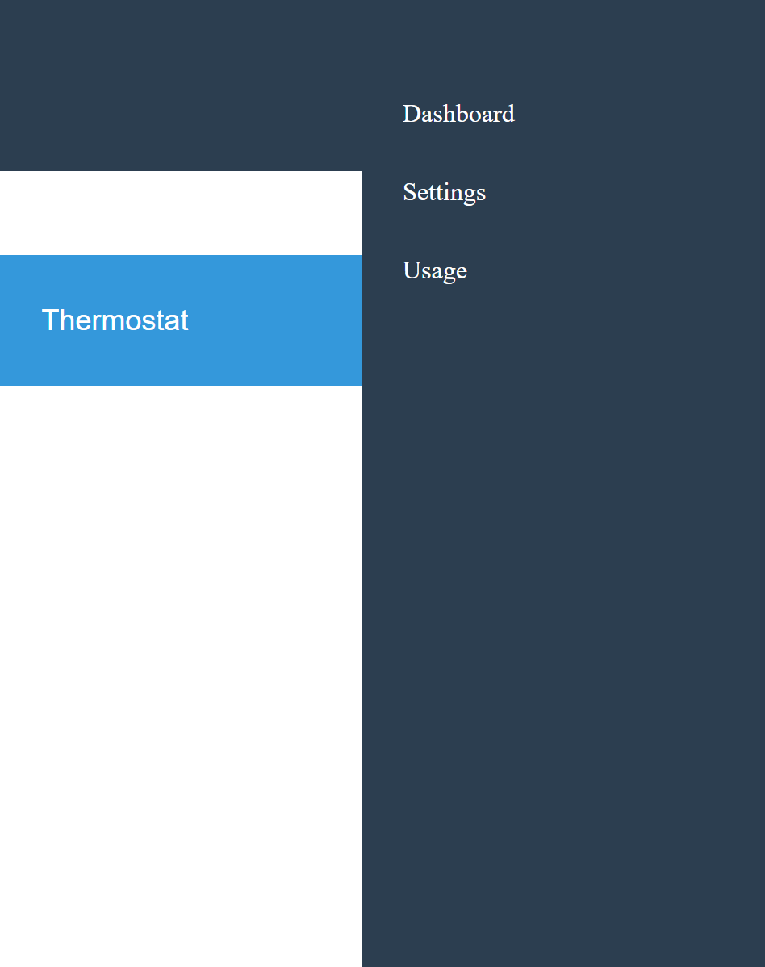
Web and Mobile App
Matthew McLean

Slide 8
Subsystem 2: IoT Hardware
Tyler Mayou
Accomplishments since 403 0 hrs of effort | Ongoing progress/problems and plans until the next presentation
No accomplishments since 403 Subsystem works the same as it did at the end of 403 | Speak with Sponsor about modifications and determine necessary parts for modifications

Slide 9
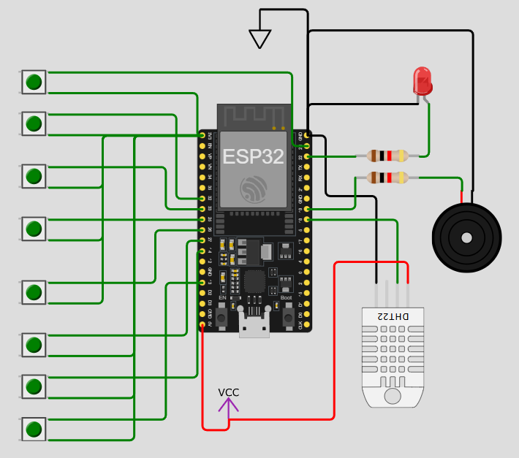
Subsystem 2: IoT Hardware
Tyler Mayou
The image shows the current circuit of the PCB.
The PCB works as desired
The LED may change to a light bulb with a relay (to be discussed with Sponsor).
Minor errors with the temp/humidity sensor

Slide 10
Subsystem 3: Database and Host
Nick Tool
Accomplishments since 403 1 hr of effort | Ongoing progress/problems and plans until the next presentation
-Researched public IP address solutions (Dynamic DNS, Public IP, AWS) - Researched security measures associated with public access (Firewall, Port Forwarding, Reverse Proxy, HTTPS) | -Implement and validate solution to allow public access, add security features - Choose communication methods that allow group members to connect to the host and database

Slide 11
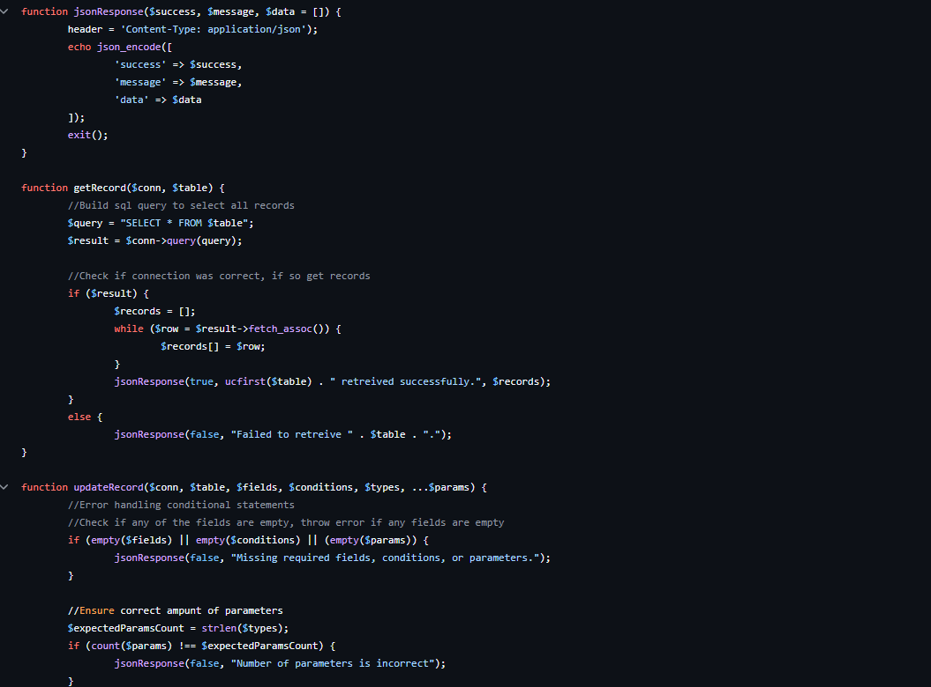
Subsystem 3: Database and Host
Nick Tool
Backend logic working as expected
On private Wifi network, all systems working
Need to add support for public access

Slide 12
Execution & Plan
Execution plan
Your team planned milestones for completion of any remaining subsystem functionality, integration of specific subsystems, test, and validation plans should be presented.
Milestones should have owners … things like final integration can be group owned
Gantt chart – should indicate some 404 progress.
Try to complete all subsystem function in next 3 weeks.
Try to complete all integration 2 weeks before demo to allow for system validation and documentatio
 | 1/20 | 1/27 | 2/3 | 2/10 | 2/17 | 2/24 | 3/3 | 3/10 | 3/17 | 3/24 | 3/31 | 4/7 | 4/14 | 4/21 | 4/28 | Legend
Matthew McLean |  |  |  |  |  |  |  |  |  |  |  |  |  |  |  | Finished
Update Layout Of Website |  |  |  |  |  |  |  |  |  |  |  |  |  |  |  | Working on it
Integrate System with Host Server |  |  |  |  |  |  |  |  |  |  |  |  |  |  |  | Haven’t Started
Integrate Entire System
Nick Tool
Implement Public IP address
Implement Security Features
Integrate Host System with Mobile App and Website
Integrate Host System with IoT Hardware
Validate App & Website Integration
Validate IoT Hardware Integration
Test and Validate Basic Functions in Fully Integrated System
Test Edge Cases in Fully Integrated System
Tyler Mayou
Discuss 404 modifications
Order/integrate parts for modification
Bluetooth Communication
Team
Update #2
Update #3
Update #4
Update #5
Final Presentation
Final Demo
Final Report
Begin Integration
Continue Integration
Final Integration
Notes:
Michelle

Slide 13
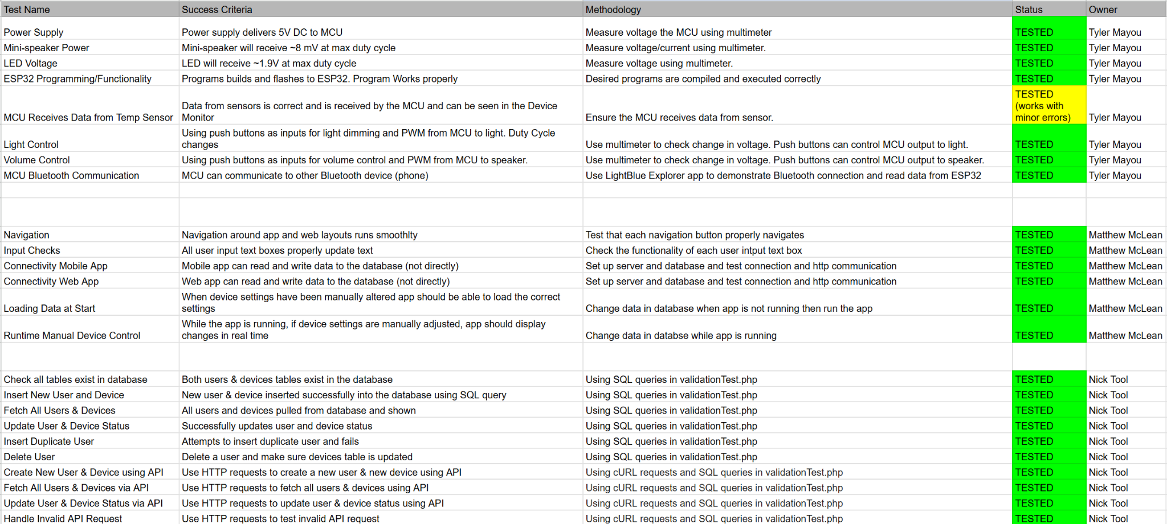
Validation Plans
From 403

Slide 14
Thank you

